Slide 1
ASP.NET MVC CORE
Instructor: Edwin oduor

Slide 2

Quote of the day

Slide 3
Lesson objectives
CRUD Operations
Implementing CRUD Operations
Migrations

Slide 4
Lesson pre-requisites
In order to take full advantage of this section you need to have the following;
Computer with Visual Studio Installed.
Stable Network Connection.

Slide 5
Training methods and extra readings
TRAINING METHODS FOR THIS LESSON
EXTRA READINGS
Lecturing Method – This is the main method of training to be adopted in this lesson with illustrations and practical coding examples.
Discussion Method - This method will be adopted periodically whereby learning will be derived principally from the students brainstorming together, rather than from the trainer. Three main types of discussions will be used:
Directed discussion
Developmental discussion
Problem-Solving discussion
Home and Learn C#

Slide 6
CRUD OPERATIONS

Slide 7
CRUD – Create Read Update Delete, will be performing the following actions in the repository class will create a method then call it to use in our program.

Slide 8
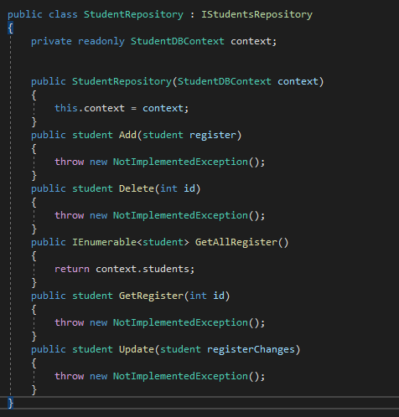
Will go back to the student repository class so that we can implement the various crud operations.

Slide 9

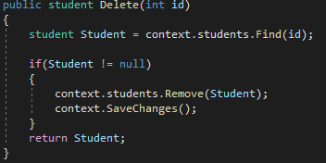
Method to add new record
Method to delete
Add Method
Delete Method

Slide 10


Method to get all the records
Method to get a record using the id.
Get all
Get record by id

Slide 11
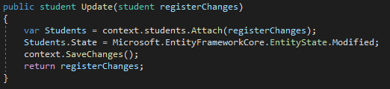
Method to Update Records

Slide 12
migrations

Slide 13
Migration is a feature in Entity Framework core that keeps Application Model and the database schema in sync.
Before a migration is done a package need to be added in our application. “Microsoft.EntityFrameworkCore.Tools”.
To Install the package Tools >> NuGet Package Manager >> Manage NuGet Packages for Solution.
NuGet Solution window is going to be opened, click on the browse tab, search for the package Microsoft.EntityFrameworkCore.Tools and install it.
Once the package has been installed. We can now go ahead and perform our migrations.

Slide 14
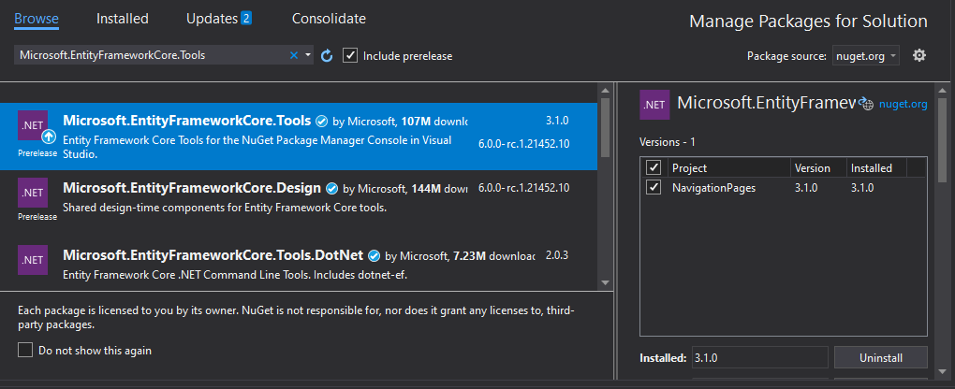
Installation Window

Slide 15
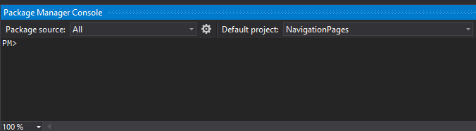
To write code to perform the migrations Tools >> NuGet Package Manager >> Package Manager Console.
The package Manager window will be opened that’s where will write our code to perform the Migrations, Mostly its located at the bottom of the window.

Slide 16
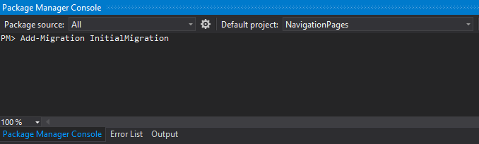
To add migration, then will type Add-Migration NameOfMigration. Tap Enter migration will be done.

Slide 17
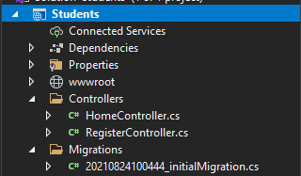
Once a migration has been performed a folder is going to be created in the solution explorer with the name that you gave the migration.

